Slide 1
Crowd Counting
- Anwesha Tomar, Jingya Gao, Wenyu Zeng

Slide 2
Introduction:
Source Data:
Images collected from a webcam in a mall, each image has a different number of people in each image (Kaggle Dataset)
Problem statement:
Object detection problem that counts the number of people in each image.
Project Design:
TensorFlow framework
Comparing custom built Keras Sequential model with pretrained Resnet 50 model

Slide 3
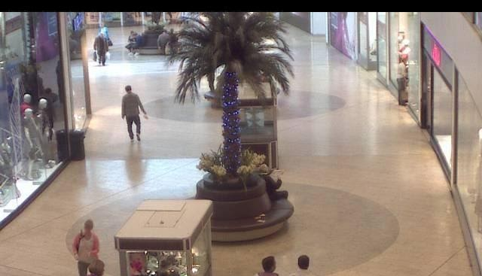
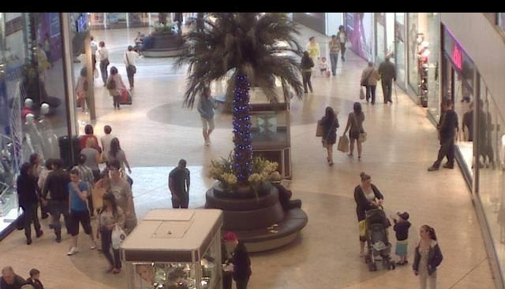
Dataset:
2000 Images
Size:480x640x3
Rezised:128x96x3

Slide 4
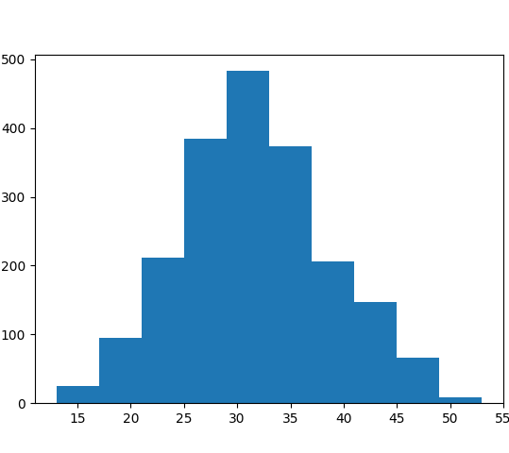
Labels:
The data is skewed

Slide 5
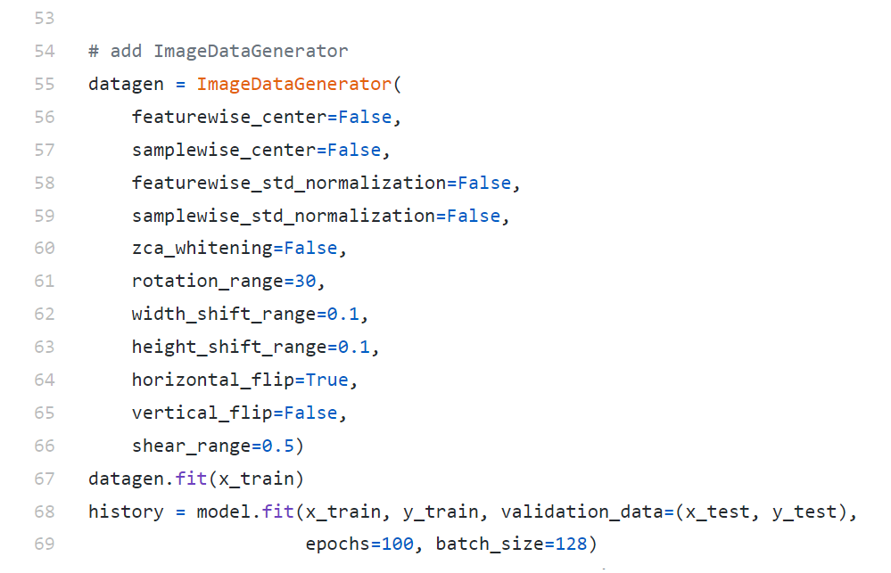
Data Generation and Augmentation

Slide 6
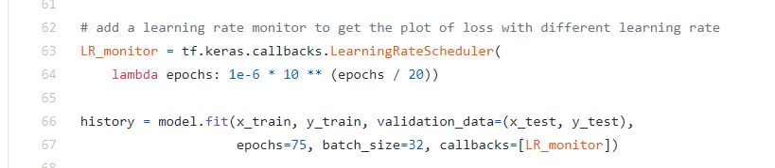
Hyper parameter selection- Learning rate

Slide 7
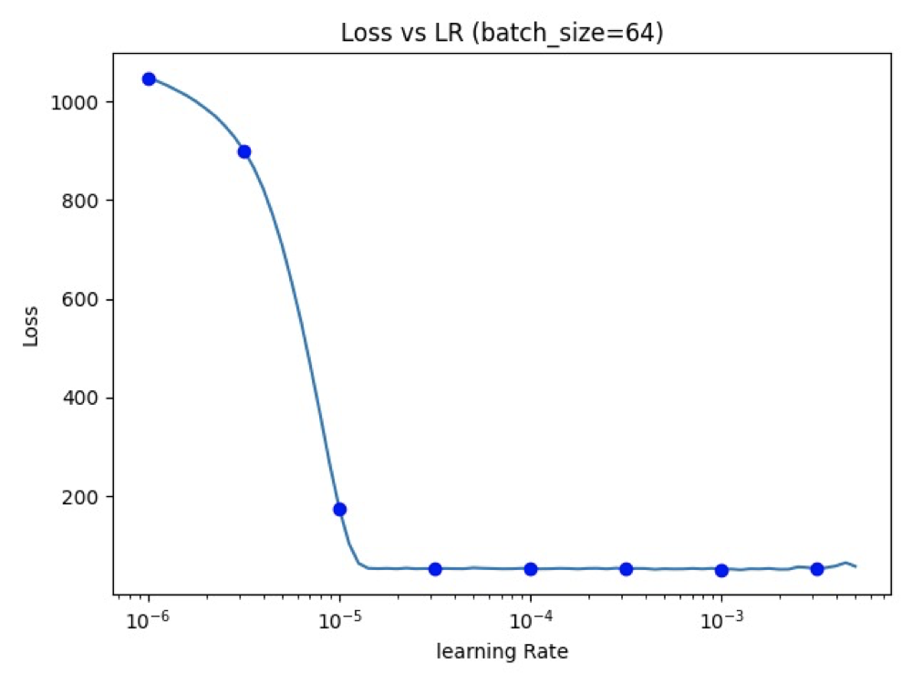
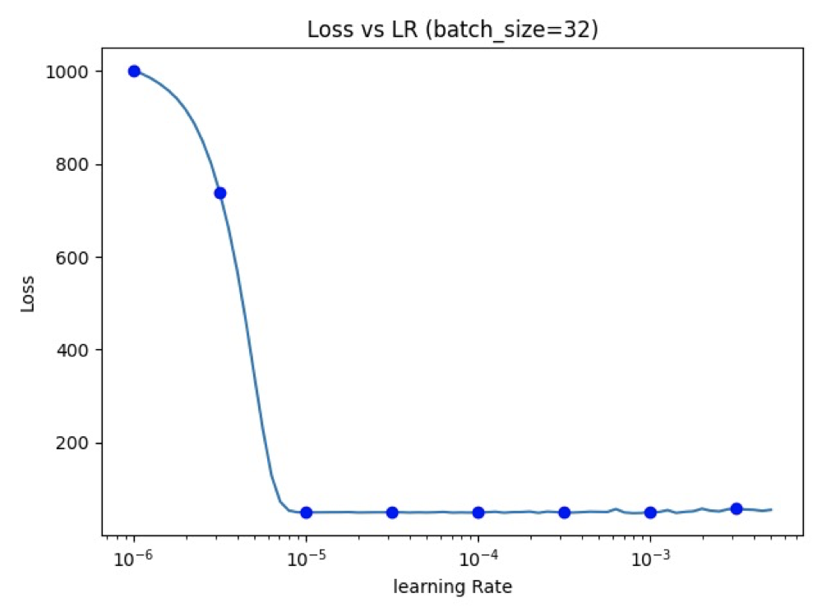
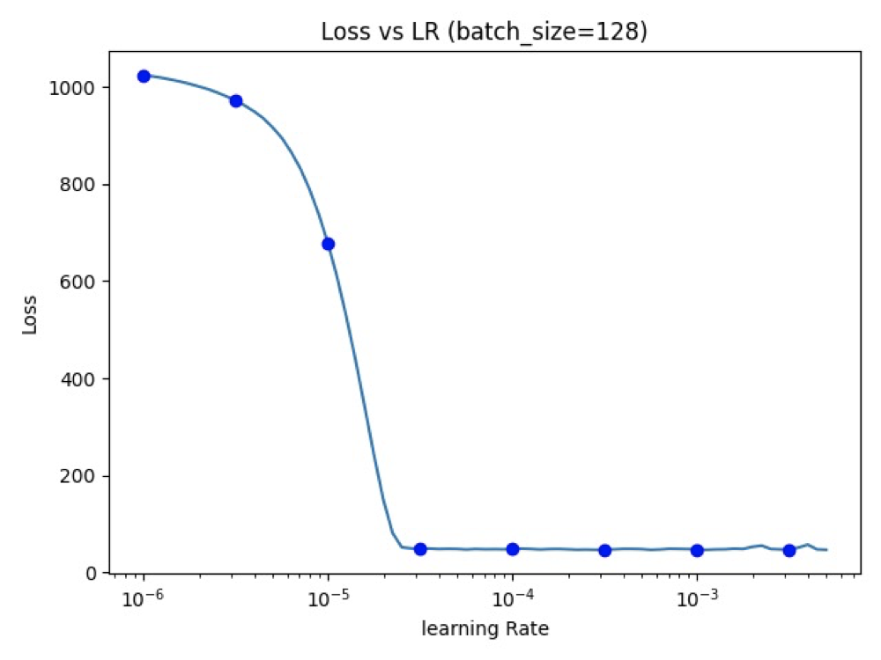
Selecting batch size:
The batch size of 32 is selected

Slide 8
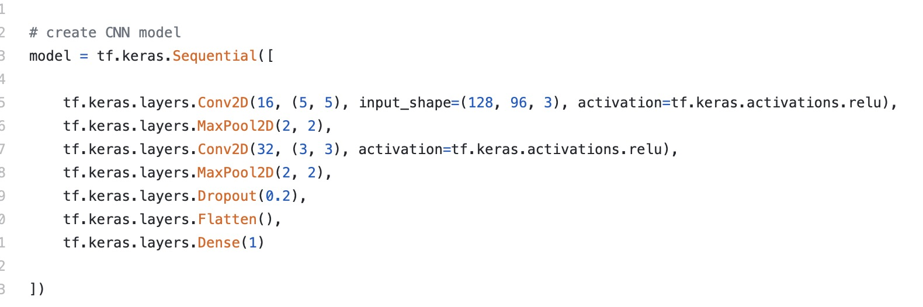
CNN Model
epochs = 100
Adam optimizer
model_check = ModelCheckpoint("keras-CNN-128-96.hdf5", monitor="val_loss", verbose=1, save_best_only=True)

Slide 9
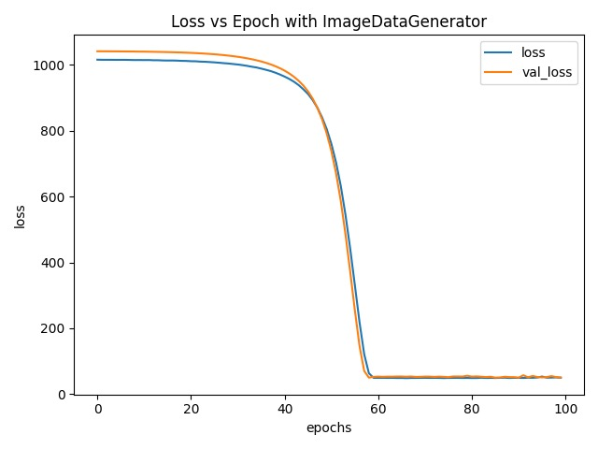
CNN Model Evaluation: val_loss: 49.9336 val_mae: 5.4904

Slide 10
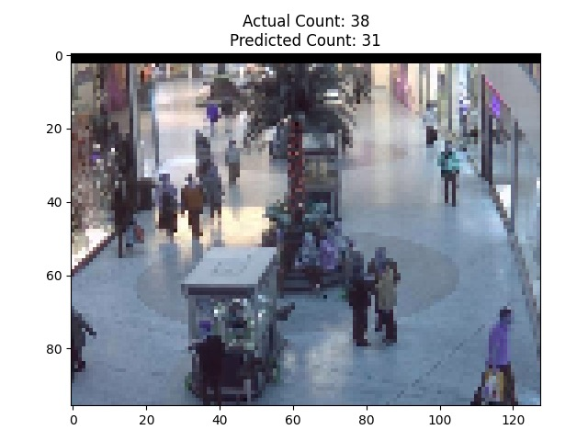
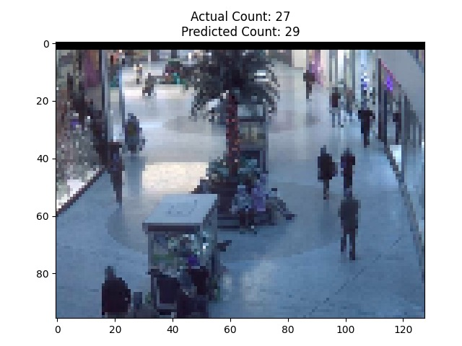
CNN Model Predict Result

Slide 11
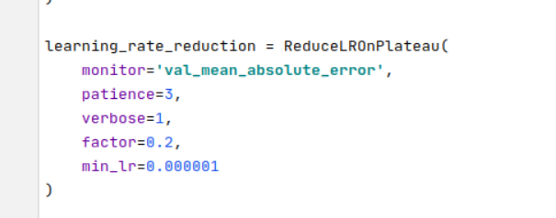
Resnet 50:
ResNet-50 is a convolutional neural network that is 50 layers deep.
90 Epochs were used for training
Made last 7 layers untrainable
Modify the output layer to predict the number of people in the image
Prevent Overfitting
Adam optimizer used for training
ReduceLROnPlateau()
Monitor on the validation mean square error
Learning rate drop 20% every 3 epochs, if the MSE does not go down
Lowest learning rate will not go beyond 1e-6

Slide 12
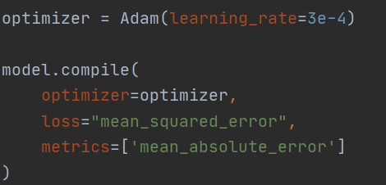
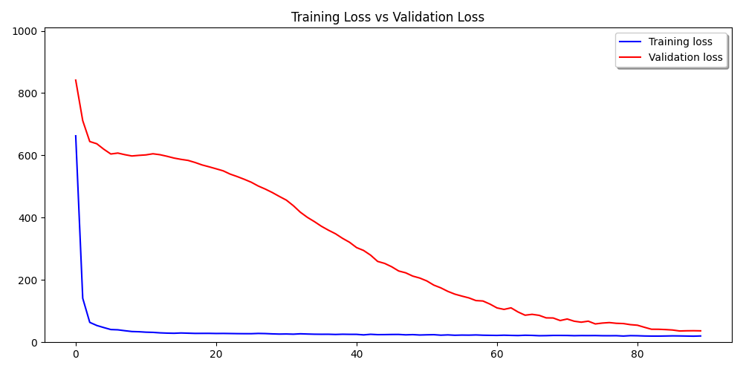
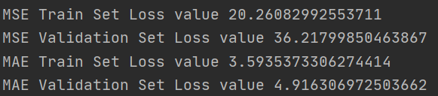
Resnet 50- Results

Slide 13
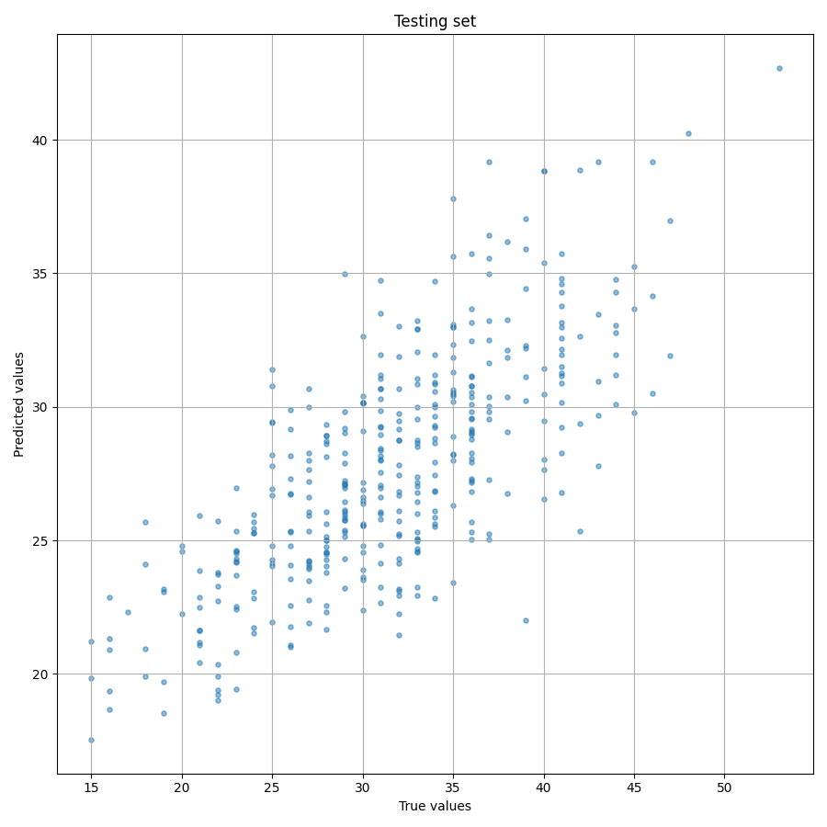
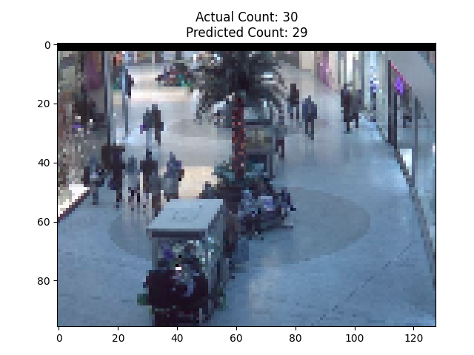
Resnet 50- Evaluation One Example of Model Prediction

Slide 14
Conclusion:
The ResNet50 model performs better
Models | Mean Absolute Error | Mean Square Error
CNN | 5.55 | 50.29
Resnet 50 | 4.92 | 36.31

Slide 15
Future Scope
MCNN model
Find more relevant datasets
Attempt to decrease loss value by ensembling models

Slide 16
Thank you!

